Slide 4
Notes:
droplet-based approaches
The system is based on droplets generation and segregation in droplet of one cell and one pre-barcoded bead carrying cell barcode+UMI+polyT primer
Published in may 2015 in Science by Macosko et al. For the dropseq and Klein et al. For the Indrop very close methods,
Amazing dataset of 44k mouse retinal cells generated in less than 48h !

Slide 5
Notes:
After the 5 minutes run you can collect the 100k droplets emulsion
Process to the Reverse Transcription in droplets (volume reactionel is 0,5 nl) , cDNA amplification, and quantification per sample of total material
Droplet size is 100µm (voluume is 4/3 pi R^3)
500.000 µm3 => 500,000 10^18 m3
=> 500,000 10^15 litre
=> 0,5 10^9 = 0,5 nanolitre

Slide 8
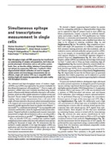
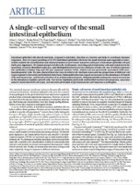
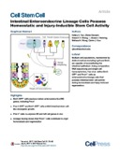
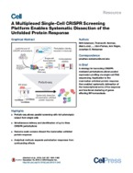
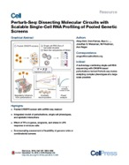
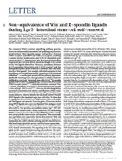
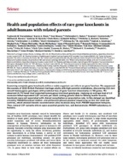

Slide 9
Notes:
SAGE profil during first time of transcriptomics

Slide 13
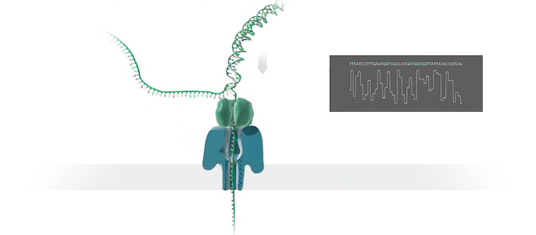

Slide 16
Notes:
Rainer waldmann bioinformatics development
Take 10 hours for 30M nanopore reads on 10 compute nodes of 20 cores and 48Gb RAM
That’s what is going to be published soon will allow everyone to setup such dataset on your favorite biological question needing single cell isoform sequencing

Slide 20
82%
69%

Slide 21
82%
69%
7%
*
Notes:
What about what’s already published in sincell cell RNA-seq
SciSir-seq from Tilgner lab

Slide 23
Notes:
It functions as the main structural component of the lattice-type cytoplasmic face of coated pits and vesicles which entrap specific macromolecules during receptor-mediated endocytosis

Slide 24
Notes:
It functions as the main structural component of the lattice-type cytoplasmic face of coated pits and vesicles which entrap specific macromolecules during receptor-mediated endocytosis

Slide 26
Notes:
But most of the molecules are seen once or two… so targeted approaches required

Slide 29
Notes:
Can represent 30% of the molecules
if you look at the %age of illumina reads on transcriptome on web_summary.html file , between 50% and 70%
RNA velocity signal is bad for long read profiling
Single cell protocols need improovement for long reads sequencing.

Slide 33
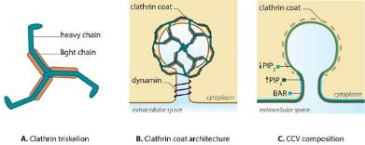
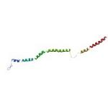
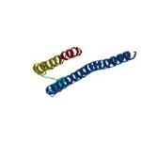
Protein alignment des 2 formes Clta-5ex (218aa) et Clta-6ex (236aa)
https://modbase.compbio.ucsf.edu/modbase-cgi/model_details.cgi?queryfile=1547307974_1248&searchmode=default&displaymode=moddetail&referer=yes&snpflag=&
Q6PFA2 (218aa)
https://modbase.compbio.ucsf.edu/modbase-cgi/model_details.cgi?queryfile=1547308030_961&searchmode=default&displaymode=moddetail&referer=yes&snpflag=&
B1AWD8 (236aa)

Slide 34
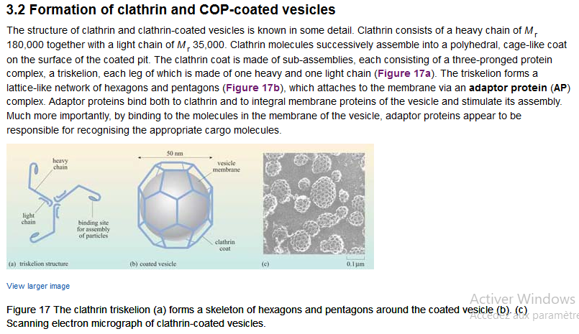
https://www.open.edu/openlearn/science-maths-technology/science/biology/intracellular-transport/content-section-3.2

Slide 35
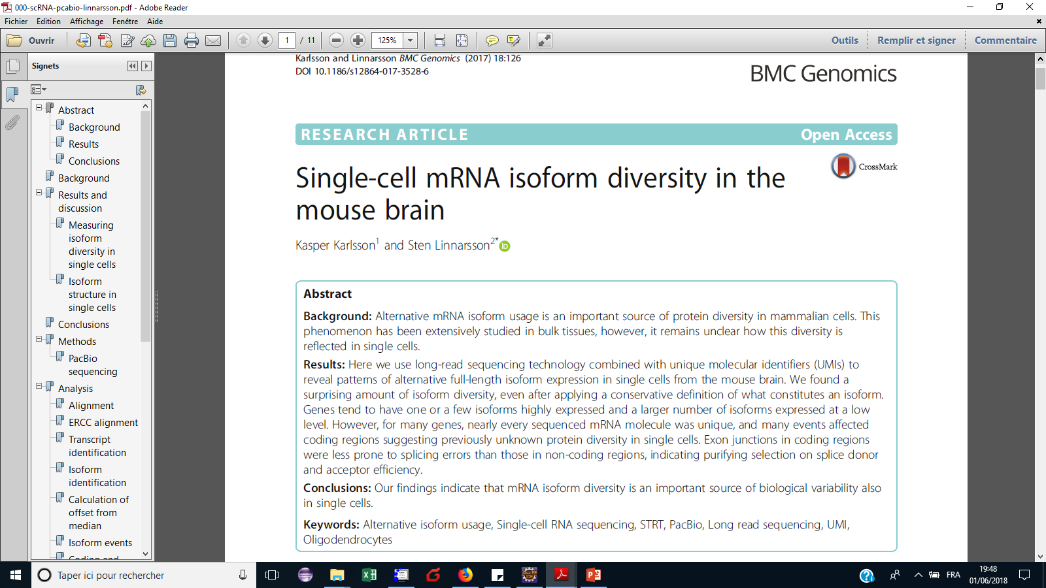
Feb.2017:
We selected six single cells for which cDNA was available from an earlier experiment … was used for PacBio sequencing. The cDNA had been produced with the STRT method adapted to the Fluidigm C1 instrument for single cell RNA sequencing

Slide 36
July 2017:
To test this, we used our ONT RNAseq approach to analyse seven individual mouse B1a cells and compared it with the standard Illumina RNAseq approach. To this end, we FACS-sorted single B1a cells into individual wells containing lysis buffer and amplified cDNA from each individual cell using the Smartseq2 protocol with modifications

Slide 37
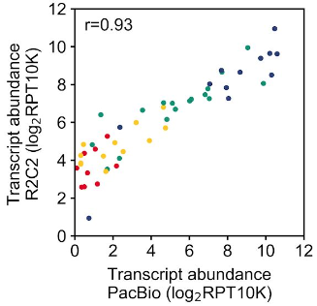
R2C2 in Vollmers’s lab
September 2018, PNAS
R2C2: Improving nanopore read accuracy enables the sequencing of highly-multiplexed full-length single-cell cDNA , Volden et al., Vollmers’s lab, bioRxiv, 2018
Plate of 96 B cells, Smart-seq2 modified protocol with Rolling Circle Amplification (RCA) and sequence with 1D R9.5 ONT flowcells. Good correlation with PacBio profiling, R2C2 can be easily adapted to any RNAseq library preparation protocol (10x, smart-seq2, drop-seq)

Slide 38
October 2018, Nature Biotechnology: ScISOr-Seq

Slide 39
October 2018, BiorXiv, Garvan Institute

